Slide 1
CSE470: Software Engineering
Software Metrics Part 1

Slide 2
What is a CFG
An abstract representation of a structured program, function or method.
Consists of two major components:
Node: Represents a stretch of sequential code statements with no branches.
Directed Edge (also called arc): Represents a branch, alternative path in execution.
Path: A collection of Nodes linked with Directed Edges.

Slide 3
Specifications of a CFG
A CFG should have:
1 entry arc (known as a directed edge, too).
1 exit arc.
All nodes should have:
At least 1 entry arc.
At least 1 exit arc.

Slide 4
Statements
All general statements can be represented as one node as there is no branch.
Statement 1;
Statement 2;
Statement 3;
Statement 4;
1
CFG

Slide 5
Conditions
All general statements can be represented as one node as there is no branch.
if X > 0: {1}
Statement1; {2}
else:
Statement2; {3}
T
2
1
4
3
F
CFG
{} -> is denoting the node numbers

Slide 6
Logical Node
A Logical Node that does not represent any actual statements can be added as a joining point for several incoming edges.
Represents a logical closure.
Example:
Node 4 from previous example
T
2
1
4
3
F
CFG

Slide 7
Loops
Every loop has 3 parts: Initialization, Condition, Increment or Decrement
So in CFG we identify each of them as a separate node.
Here we will discuss 2 types of loops: While and For

Slide 8
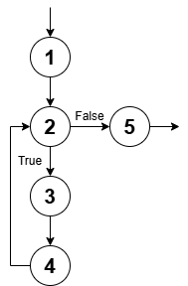
While Loops
n = 0 -> Initialization {1}
while (n < 5): -> Condition {2}
print(n) -> Body Statement {3}
n += 1 ->Increment {4}
Node-5 is a logical node here

Slide 9
For Loops
Python implement for-loop a bit differently than others. It achieves the same functionality as the other for-loops using the range() function.
range() has 3 main parameters: Start, Stop and Step
To simplify things, we will consider the following:
Start -> Initialization
Stop -> Condition
Step -> Increment/Decrement

Slide 10
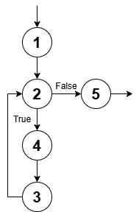
For Loops
for i in range(0, 5, 1): #{1, 2, 3}
print(n) #{4}
for i in range(0, 5): #{1, 2, 3}
print(n) #{4}
for i in range(5): #{1, 2, 3}
print(n) #{4}

Slide 11
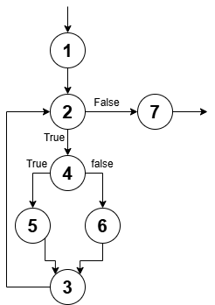
Combined Example
for i in range(0, 5, 1): {1,2,3}
if (i % 2 == 0): {4}
print(f"{i} is Even") {5}
else:
print(f"{i} is Odd") {6}

Slide 12
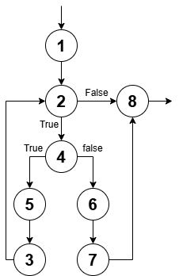
Break
for i in range(0, 5, 1): {1,2,3}
if (i % 2 == 0): {4}
print(f"{i} is Even") {5}
else:
print(f"{i} is Odd") {6}
break {7}

Slide 13
Pass
for i in range(0, 5, 1): {1,2,3}
if (i % 2 == 0): {4}
pass {5}
print("test") {5}
else:
print(f"{i} is Odd") {6}

Slide 14
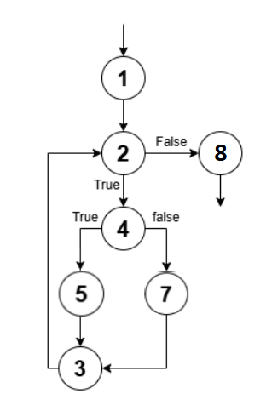
Continue
for i in range(0, 5, 1): {1,2,3}
if (i % 2 == 0): {4}
continue {5}
print("test") {6}
else:
print(f"{i} is Odd") {7}

Slide 15
Number of Paths
Given a program, how do we exercise all statements and branches at least once?
Translating the program into a CFG, an equivalent question is:
Given a CFG, how do we cover all arcs and nodes at least once?
Since a path is a trail of nodes linked by arcs, this is similar to ask:
Given a CFG, what is the set of paths that can cover all arcs and nodes?

Slide 16
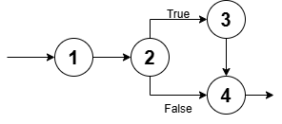
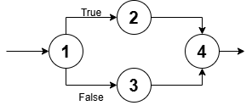
Example
1
CFG
Two paths are needed:
  [ 1 – 2 – 4 ]
  [ 1 – 2 – 3 – 4 ]
Only one path is needed:
[ 1 ]
Two paths are needed:
  [ 1 – 2 – 4 ]
  [ 1 – 3 – 4 ]

Slide 17
White Box Testing: Path Based
A generalized technique to find out the number of paths needed (known as cyclomatic complexity) to cover all arcs and nodes in CFG.
Steps:
Draw the CFG for the code fragment.
Compute the cyclomatic complexity number C, for the CFG.
Find at most C paths that cover the nodes and arcs in a CFG, also known as Basic Paths Set;
Design test cases to force execution along paths in the Basic Paths Set.

Slide 18
Path Based Testing: Step 1
A = [1, 3, 5 ,8, 9, 43] {1}
min = A[0] {1}
i = 1 {1}
while (i < len(A)): {2}
if (A[i] < min): {3}
min = A[i] {4}
i = i + 1 {5}
print(min) {6}
1
2
F
T
3
F
T
5
4
6
CFG

Slide 19
Path Base Testing: Step 2
1. The complexity M is then defined as
M = R + 1,
where R = the number of regions in the graph.
2. The complexity M is then defined as
M = P + 1,
where P = the number of predicate nodes in the graph.
3. The complexity M is then defined as
M = E − N + 2P,where
  E = the number of edges of the graph.
  N = the number of nodes of the graph.
  P = the number of connected components.

Slide 20
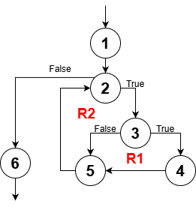
Path Base Testing: Step 2
Cyclomatic complexity M =
The number of ‘regions’ in the graph( R ) + 1
M = R + 1
M = 2 + 1 = 3

Slide 21
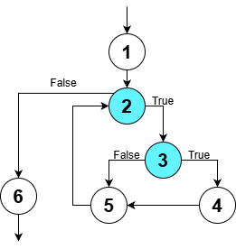
Path Base Testing: Step 2
Cyclomatic complexity M =
The number of ‘predicate’ nodes ( P ) + 1
M = P + 1
M = 2 + 1 = 3
Here, Predicate node means Decision Node

Slide 22
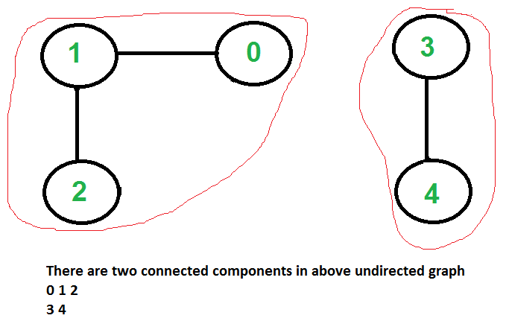
Connected Component in a Graph

Slide 23
Path Base Testing: Step 2
Cyclomatic complexity, M =
E − N + 2P, Where
E, edges = 7 (exclude: entry, exit arc)
N, nodes = 6
P, connected components = 1
= 7 – 6 + (2x1)
= 3

Slide 24
Path Base Testing: Step 3
Independent path:
An executable or realizable path through the graph from the start node to the end node that has not been traversed before.
Must move along at least one arc that has not been yet traversed (an unvisited arc).
The objective is to cover all statements in a program by independent paths.
The number of independent paths to discover <= Cyclomatic complexity number, M
The set of Independent paths is called Basic Path Set

Slide 25
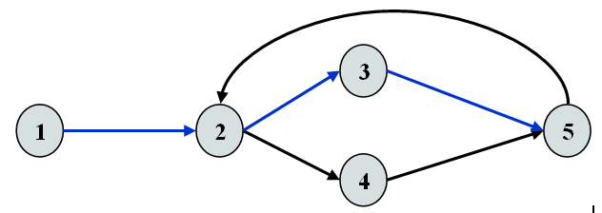
Example
M = Regions + 1 = 2 + 1 = 3
1-2-3-5 can be the first independent path; 1-2-4-5 is another; 1-2-3-5-2-4-5 is one more.
Alternatively, if we had identified 1-2-3-5-2-4-5 as the first independent path, there would be no more independent paths.
The number of independent paths therefore can vary according to the order we identify them.

Slide 26
Path Base Testing: Step 3
Cyclomatic complexity = 3.
Need at most 3 independent paths to cover the CFG.
In this example:
[ 1 – 2 – 6 ]
[ 1 – 2 – 3 – 5 – 2 – 6 ]
[ 1 – 2 – 3 – 4 – 5 – 2 – 6]
1
2
F
T
3
F
T
5
4
6
CFG

Slide 27
Path Based Testing Example
A = [5, 3, 5 ,8, 9, 43] {1}
min = A[0] {1}
i = 1 {1}
while (i < N): {2}
if (A[i] < min): {3}
min = A[i] {4}
i = i + 1 {5}
print(min) {6}
Prepare a test case for each independent path.
In this example:
Path: [ 1 – 2 – 6 ]
Test Case: A = { 5, …}, N = 1
Expected Output: 5

